Slide 1
Issue tracker project
Ranken - AWD 1111 Database Driven Web Development Final Project
3rd Semester - Fall 2022
By Joshua Mandel

Slide 2

About The Project
As a 3rd Semester student at Ranken, I was tasked with the objective of making an issue tracker using the MERN technology stack. We had most of the semester to plan, code, edit, and design the entire application and built it with React.js, Express.js, Node.js, and MongoDB

Slide 3
M.E.R.N. pt.1
MongoDB
Express.js
MongoDB is a non-relational document database that provides support for JSON-like storage. The MongoDB database has a flexible data model that enables you to store unstructured data, and it provides full indexing support, and replication with rich and intuitive APIs.
Express.js, or simply Express, is a back end web application framework for building RESTful APIs with Node.js, released as free and open-source software under the MIT License. It is designed for building web applications and APIs.[3] It has been called the de facto standard server framework for Node.js.

Slide 4
M.E.R.N. pt.2
React.js
Node.js
React is a free and open-source front-end JavaScript library for building user interfaces based on UI components. It is maintained by Meta (formerly Facebook) and a community of individual developers and companies.
Node.js lets developers use JavaScript to write command line tools and for server-side scripting. The functionality of running scripts server-side produces dynamic web page content before the page is sent to the user's web browser. Consequently, Node.js represents a "JavaScript everywhere" paradigm,[6] unifying web-application development around a single programming language, rather than different languages for server-side and client-side scripts.

Slide 5
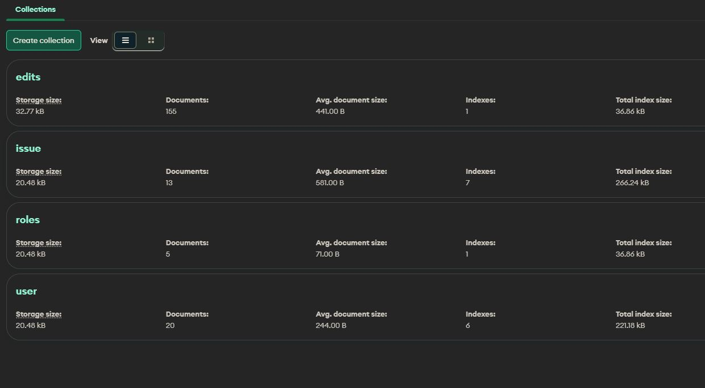
Mongodb

Slide 6
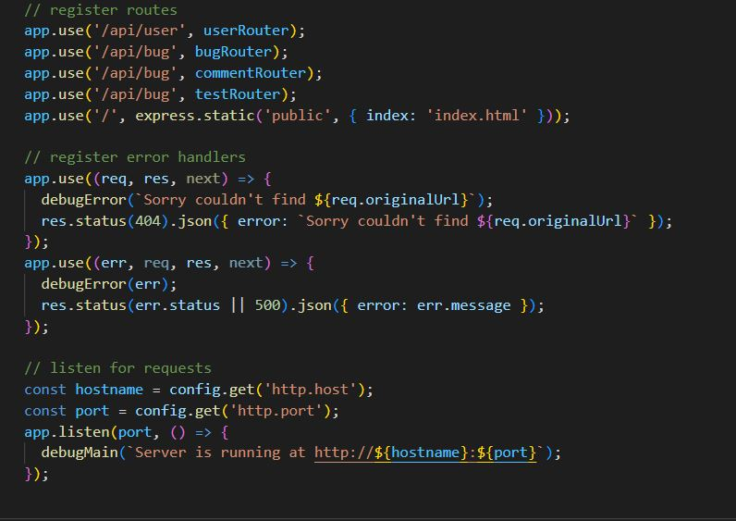
Express.js

Slide 7
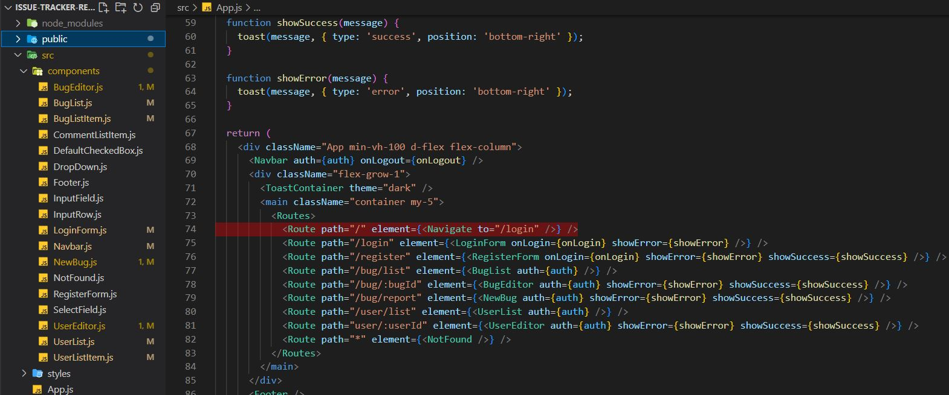
REACT.js

Slide 8
Node
Key Features
The project allows users to keep track of bugs
Update data about bugs and users
Classify bugs and users by roles and classification to make organization easier

Slide 9
Project Background
Building this project was one of the hardest parts of my coding journey so far. I have learned so much about web applications and reading and manipulating data. If I were to do anything differently it would be to make sure I double check and test code before committing and pushing to my repository. This would have saved me countless hours later in the project building process.

Slide 10
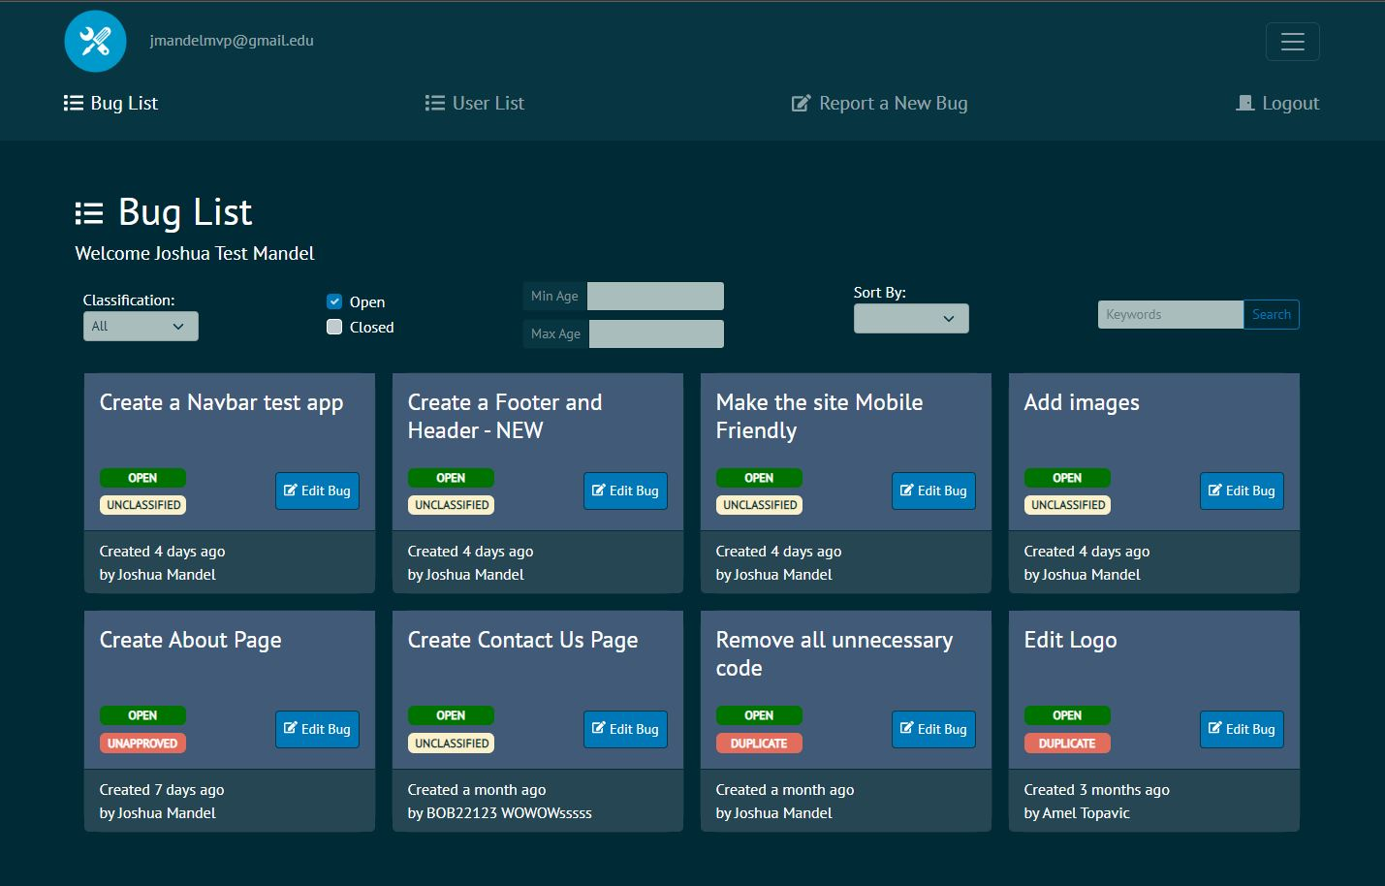
Project Screenshot

Slide 11
Now the demo!

